Slide 1
BASIC RADIATION PHYSICS

Slide 2
topics
Structure of atom
Classification of radiation
Electromagnetic spectrum
Properties of a wave
Interaction of x-rays with matter

Slide 3
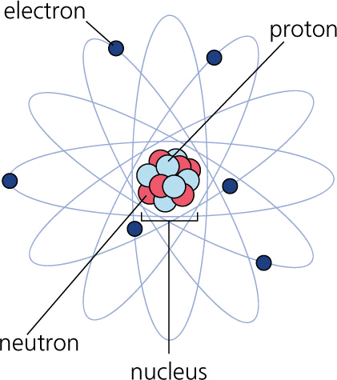
Structure of an atom

Slide 4
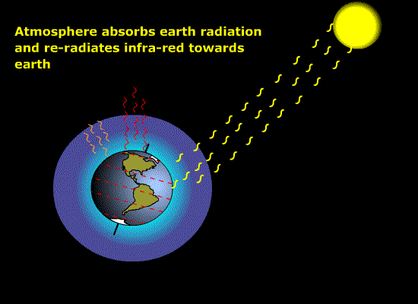
Energy emitted and transferred or propagated through matter is called radiation

Slide 5
CLASSIFICATION OF RADIATION
RADIATION
IONISING
PARTICULATE
ELECTRO MAGNETIC
NONIONISING

Slide 6
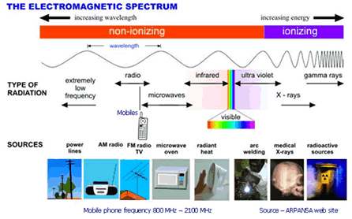
ELECTROMAGNETIC SPECTRUM

Slide 7
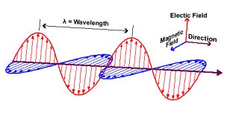
Electromagnetic radiation

Slide 8
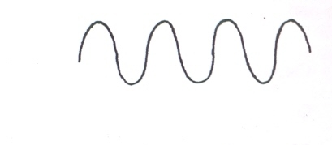
WAVE
crest
trough

Slide 9
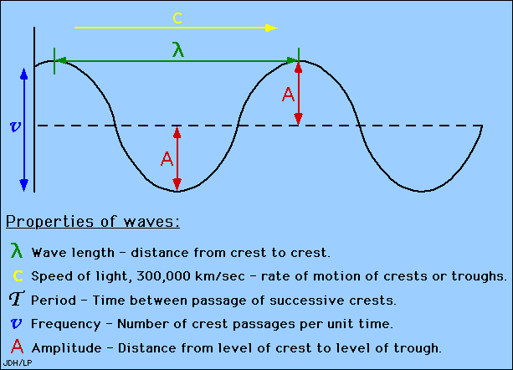
Properties of wave

Slide 10
BASIC INTERACTION OF X-RAY WITH MATTER
Photo electric effect
Coherent scattering
Compton effect
Pair production
Photo disintegration

Slide 11
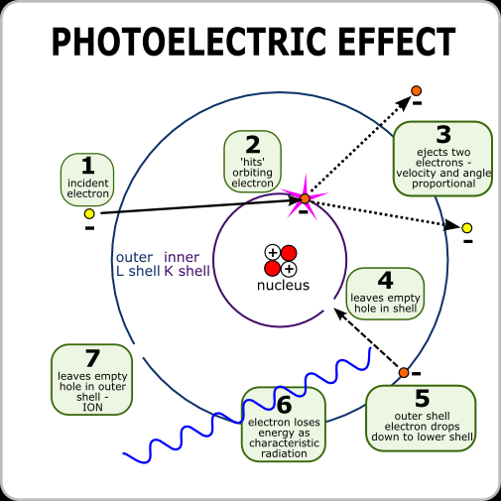

Slide 12
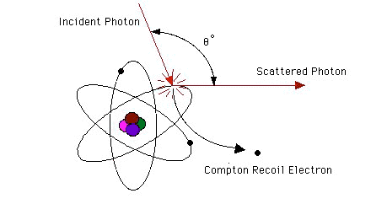
COMPTON EFFECT

Slide 13
TYPES OF X-RAY MACHINE
Portable
Mobile
Fixed

Slide 14
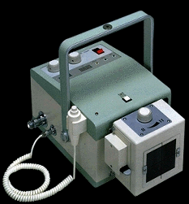
PORTABLE
CABLE
X-RAY TUBE

Slide 15
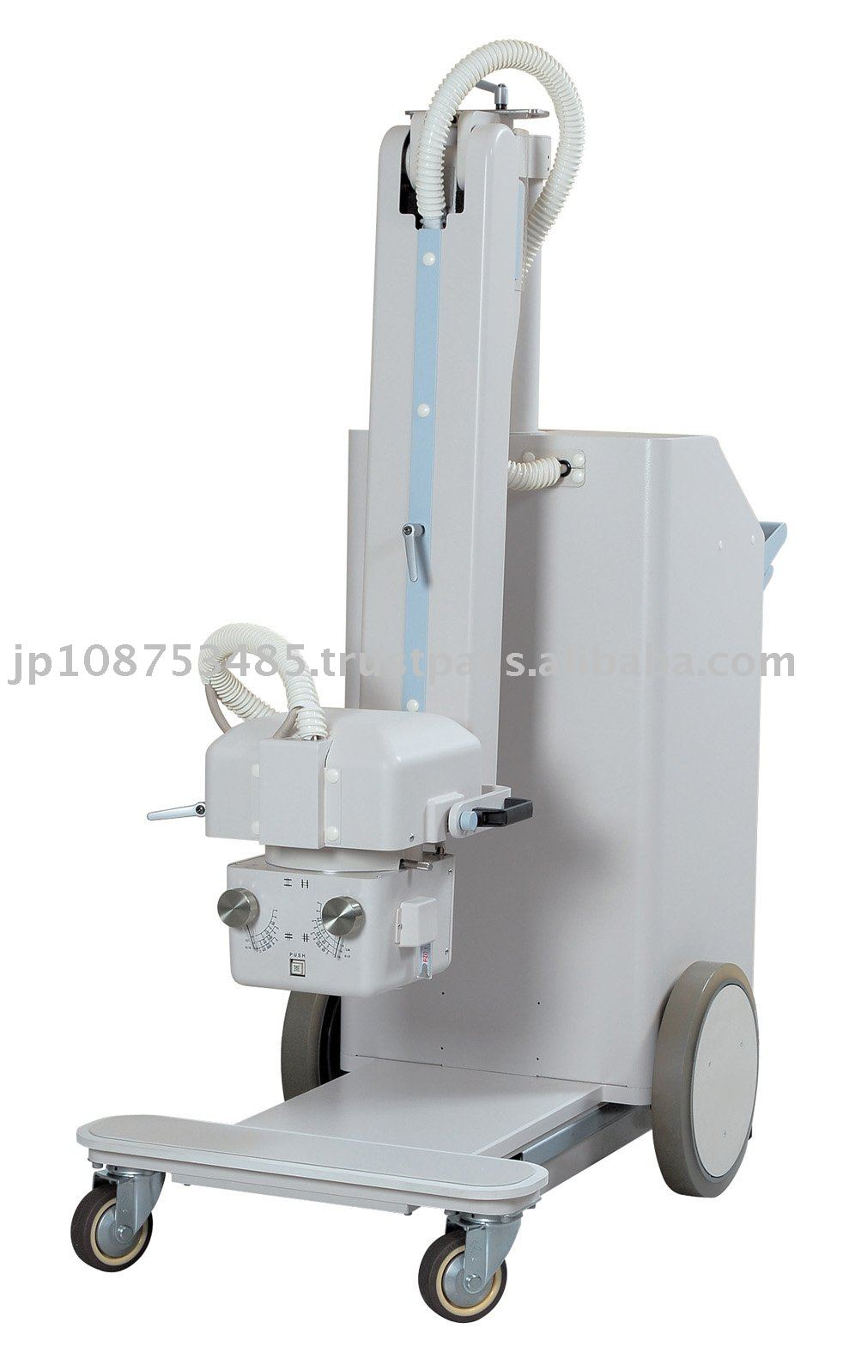
MOBILE
CABLE
TRANSFORMER
X-RAY TUBE
MOBILE WHEELS

Slide 16
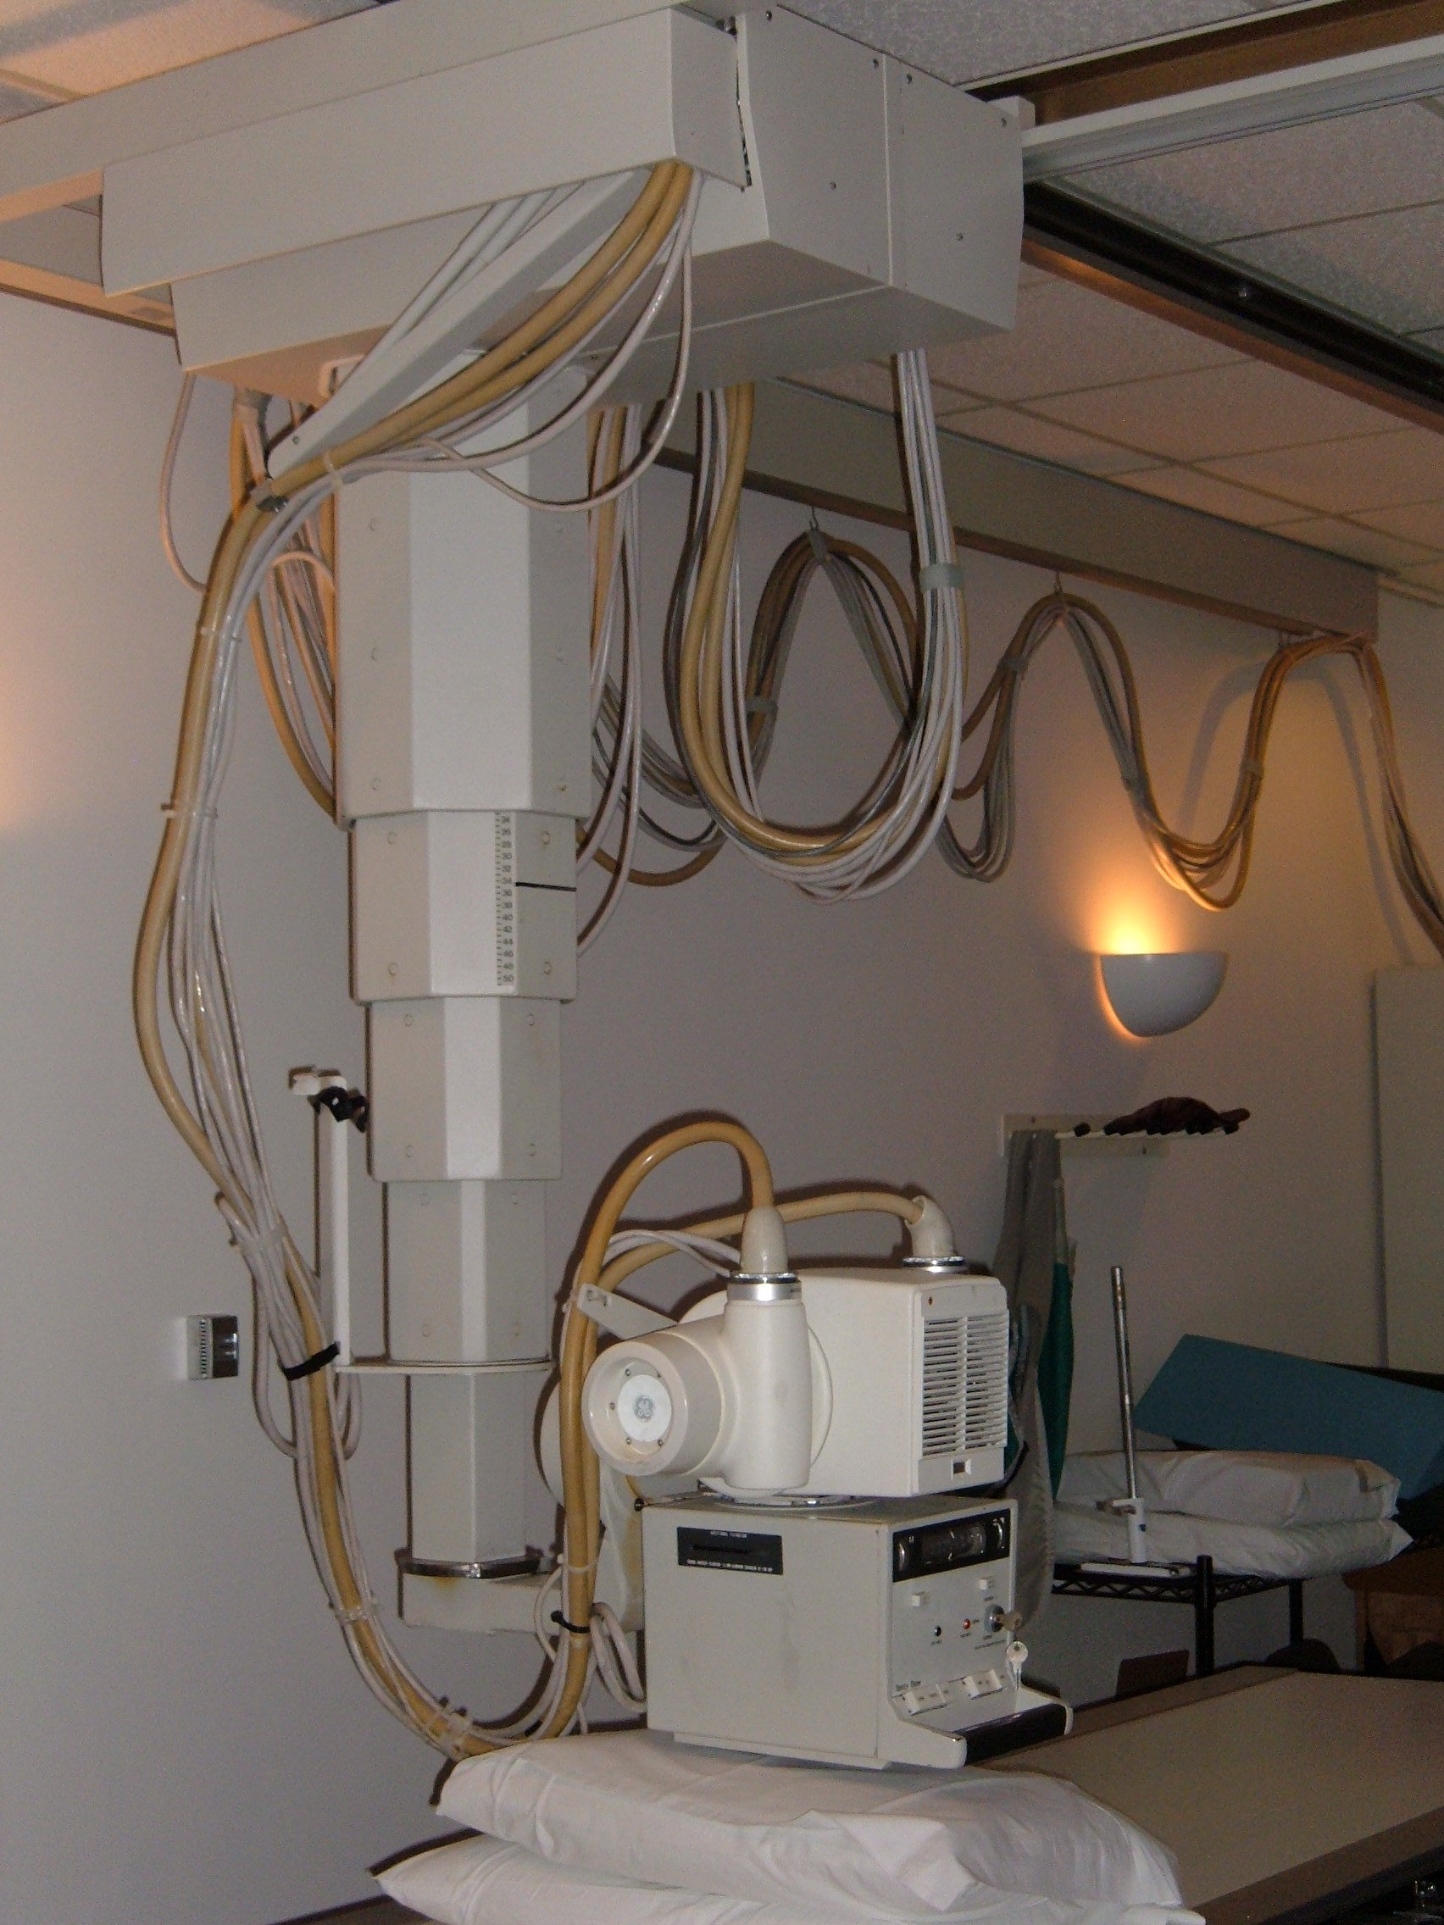
FIXED

Slide 17
REFERENCES:-
-VETERINARY RADIOLOGY-A.P. SINGH & JIT SINGH

Slide 18


