Slide 1
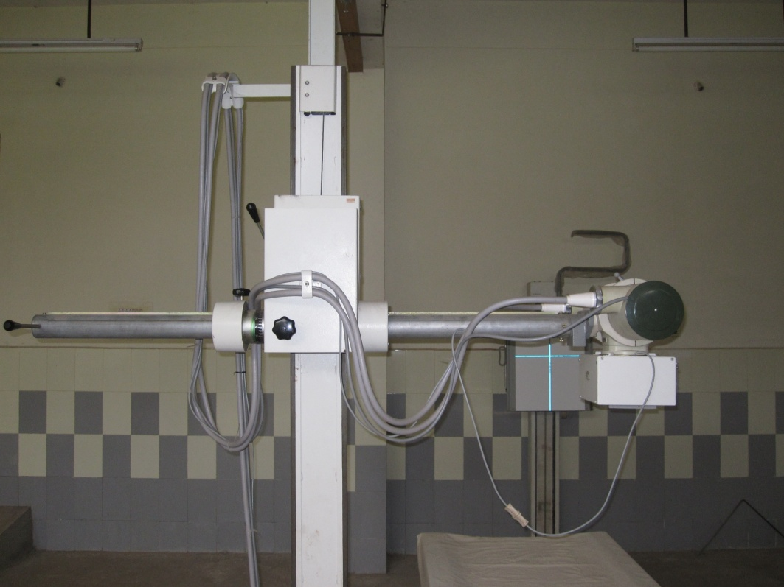
RADIOGRAPHIC PROCESSING
Dr.K.S.Saikrishna

Slide 2
All the work will go in vain if processing is faulty.
Processing will be done in dark room.
Dark room errors may result in repeated radiographic examination.
PROCESSING
Manual
Automatic

Slide 3
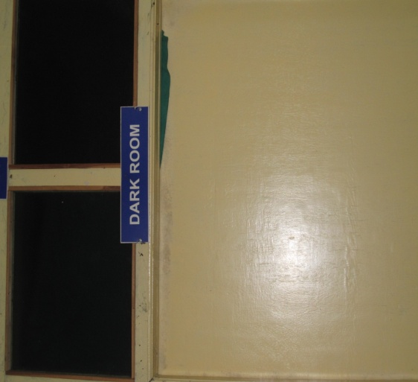
Dark room:
proper planning is important while constructing a dark room.
Construction:
- sufficient space(> 6 X 8 ft)
- near to X-ray examination room
- walls with concrete
- floor should be impervious eg., linoleum
- sufficient running water
- light proof
- Entry through double doors
- No extreme temp. variations

Slide 4
Safelight
  number (as low as possible), distance from the table
  type and colours of filters
  bulb colour (red) or adapted to film
  power (< 25 W)
External light tightness
Hygrometry (30 - 60%)
Room temperature < 20°
Film storage conditions

Slide 5
DARKROOM ENTRANCE: REVOLVING DOOR

Slide 6
DARKROOM ENTRANCE:
SINGLE DOOR

Slide 7
DARKROOM ENTRANCE:
DOUBLE DOOR

Slide 8
DARKROOM ENTRANCE:
MAZE

Slide 9
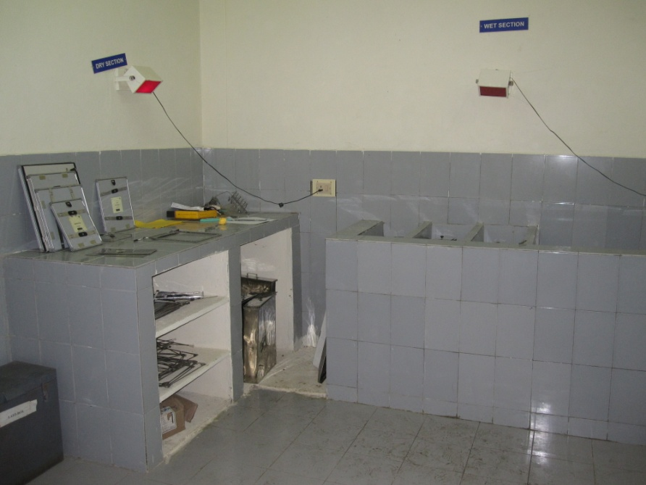
Lay out
purpose:
To maintain orderly flow of work
Left to right side.
Enough space between dry and wet sections to avoid splashing or maintain partition .

Slide 10
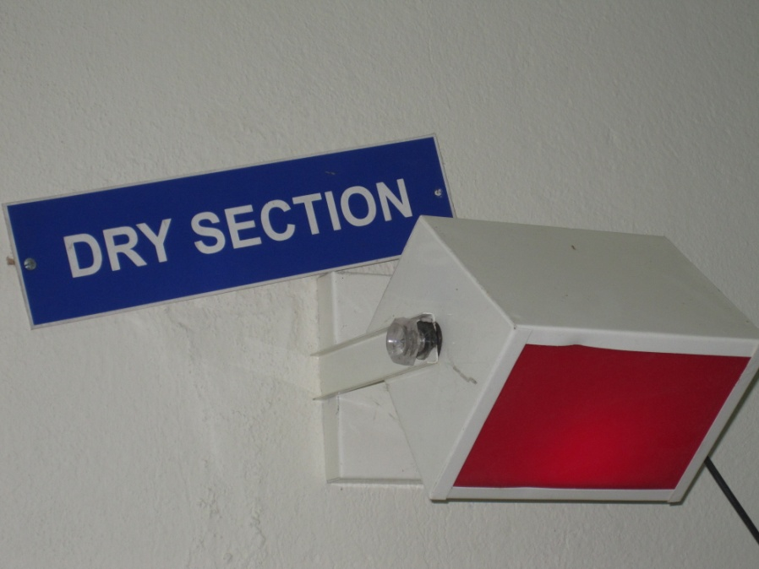
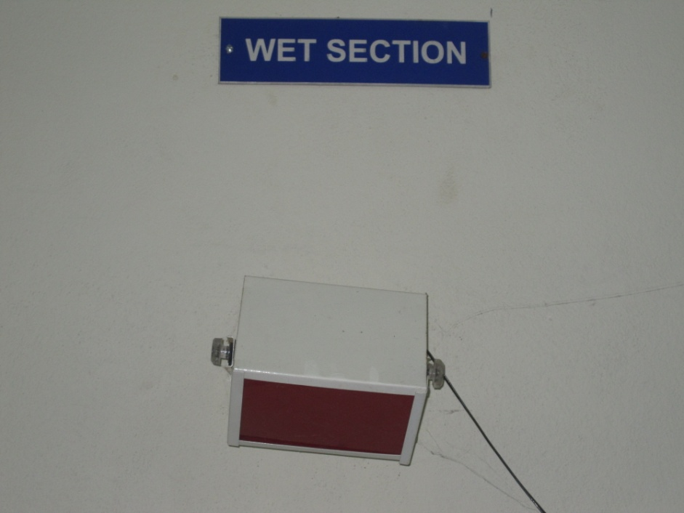
DARK ROOM

Slide 11
Dry section:
- Dry bench preferably 3’ x 2’ dimensions.
- Height of 3 feet
- cupboard to store
- Top surface of bench wood & heavy linoleum.
- Lead box
- Safe light
Wet section :
- Sink to keep processing tanks
- China tiles & safelight
- Viewer near the fixer for emergency
- Drying cabinet

Slide 12
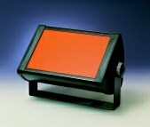
The safelight must be located no less than 4 feet from
the work surface so that you can open film
packets and process films safely.
- direct
- indirect
< 15 watts

Slide 13
Dark room light proofing:
- locate light leaks
- double door or revolving door
- sealing bottom of the door
- walls with light colour

Slide 14
Processing tanks:
9,13,22 liters capacity
Plastic or stainless steel , hypochlorite/bleaching powder.
4 tanks ------- Developer
Rinser
Fixer
Washer

Slide 15
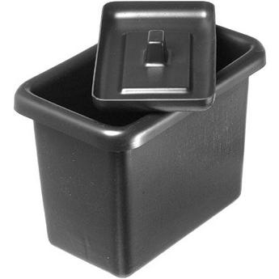

PLASTIC TANK
STAINLESS STEEL

Slide 16
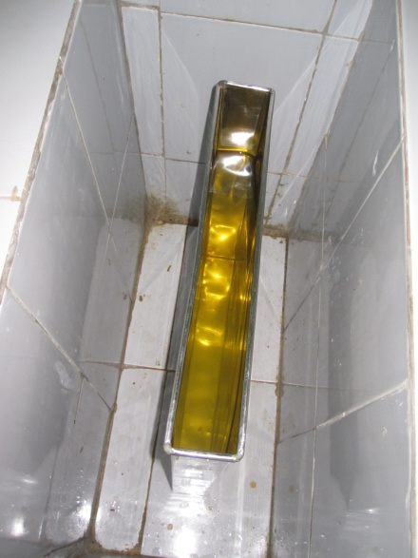
Processing solutions:
DEVELOPER : 4 –5 minutes
Reduces silver halide crystals of the film to metallic silver to convert latent image to visible one.
Reducing agent : hydroquinone
Activator : Sodium carbonate
Restrainer : Potassium bromide
Preservative : sodium sulphide
Solvent : water

Slide 17
Rinser :
prevents over developing and forwarding of developer.
128 ml of glacial acetic acid in one litre of water.
10-30 seconds by agitating film.

Slide 18
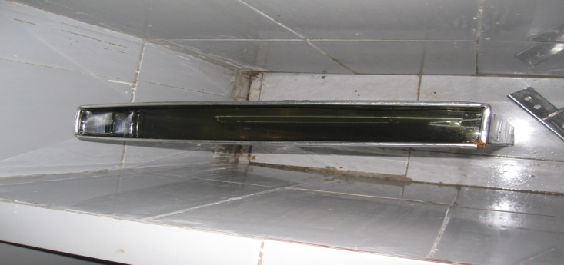
Fixer:
removal of unexposed silver crystal
stops development by neutralizing
shrinks & hardens the film emulsion.
fixing agent : Sodium/ Ammonium thio
sulphate
Acidifier : Acetic acid / sulphuric acid
Hardener : Ammonium chloride/ Ammonium
sulphide
Preservative : Sodium sulphite
Solvent : Water

Slide 19
Film processing:
- Check the levels & stir with separate paddles
- Check temperatures
- selection of film hanger
- switch on safe light & switch off white light
- open cassette on dry bench
- take out film by grasping at corner
- fix film in hanger
- film in developer
- rinse
- transfer film to fixer
- wash film in running water

Slide 20
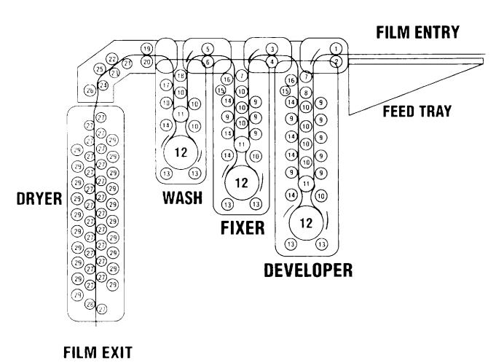
AUTOMATIC FILM PROCESSING introduced in late 1950’s

Slide 21
used if flow of work is high
eliminate dark room errors
Better quality
Processing is very fast.
Demerits:
- Expensive
- Need large quantities of solutions and replenishers.

Slide 22
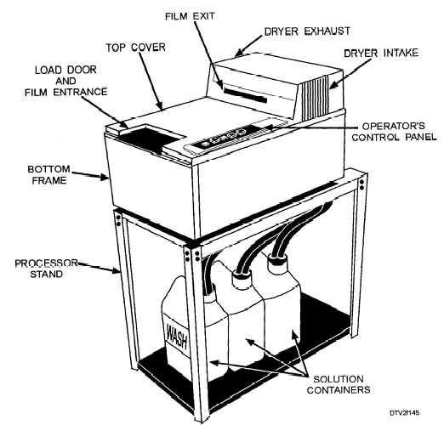
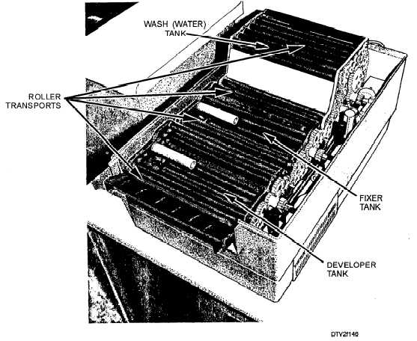

Slide 23
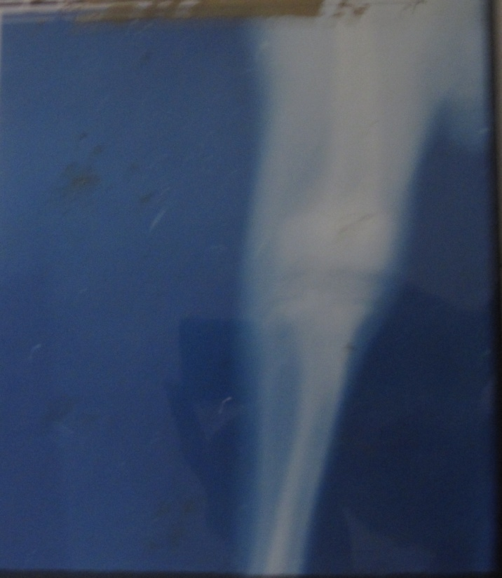
Radiographic faults
Dark radiograph:
Over exposure
Short ffd
Wrong screen film combination
Over development
Inadequate dilution of developer

Slide 24
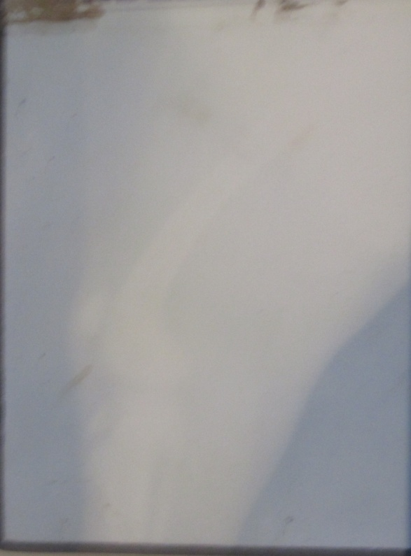
Light radiograph:
under exposure
increased ffd
wrong screen film combination
under development
2 films in same cassette

Slide 25
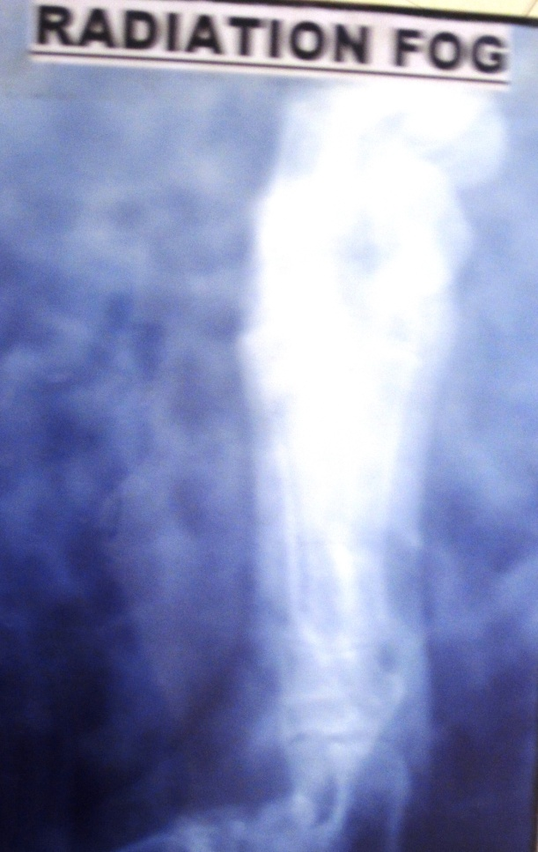
Fog: 3 types
1. radiation fog :
Exposure of film to radiation
during storage
during transport & delivery
during radiographic examination
to scatter radiation

Slide 26
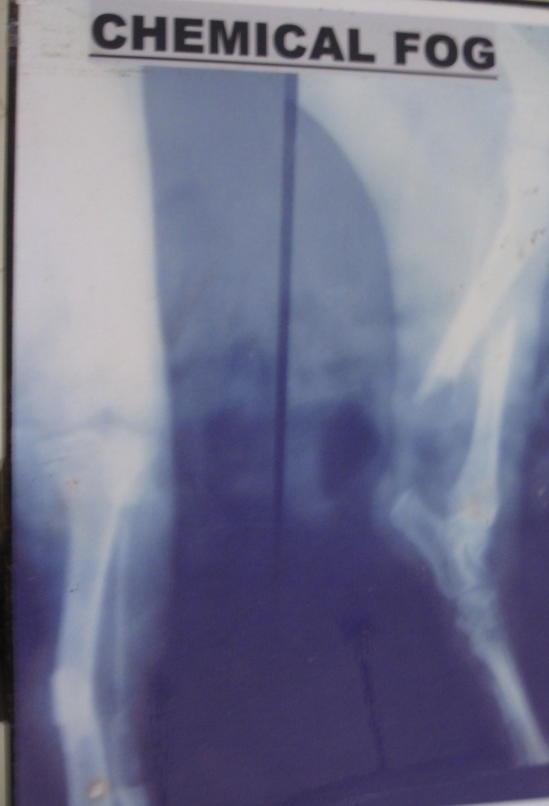
2. Chemical fog:
overdevelopment of film
exhausted or contaminated developer

Slide 27
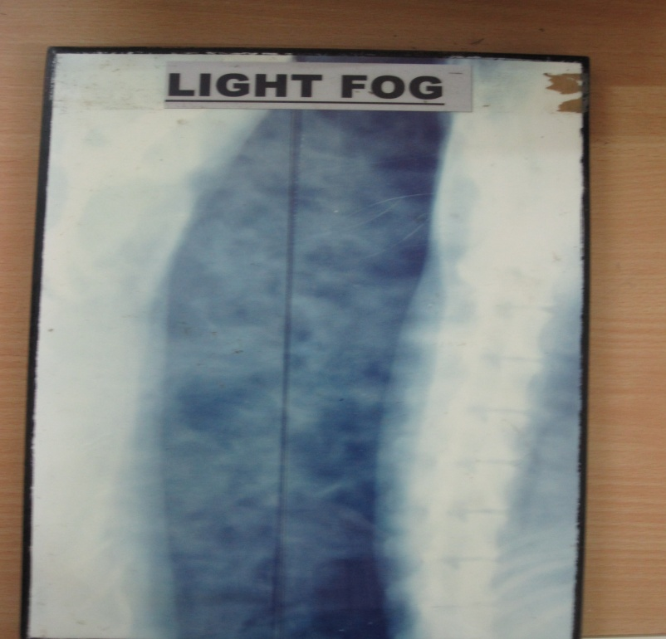
3. Light fog:
Light leakage into the dark room
Light leakage thru cassette & transfer box
Light leakage thru broken lead film storage box
Faulty safe light
Prolonged inspection during development
Turning light on before proper fixation of the film

Slide 28
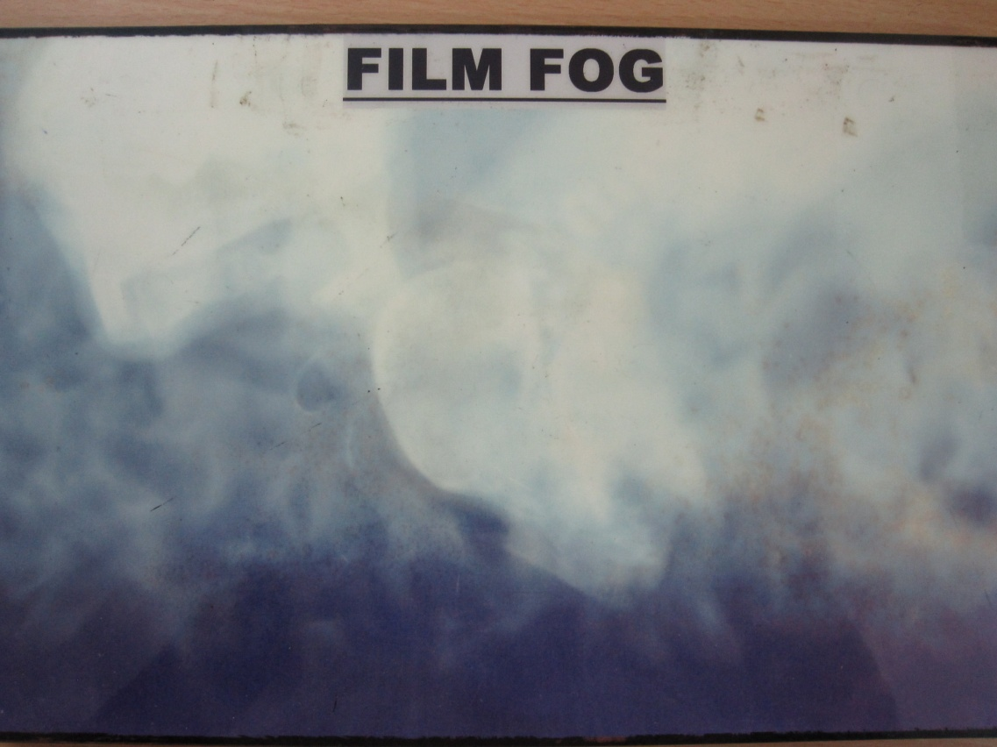
4.Film Fog:
Expired or old film
Films stored under too high temperature / humidity
Presence of ammonia or other fumes in processing room
Excessive pressure on film during storage or handling in dark room.

Slide 29
Black spots:
2 films stuck together during fixation
Splash of developer on film during processing
Dust or liquid on the processed film
linear scratches on film
Light leak into storage box
Dropping of water droplets from hangers during
drying
Pressure or bending of film during processing

Slide 30
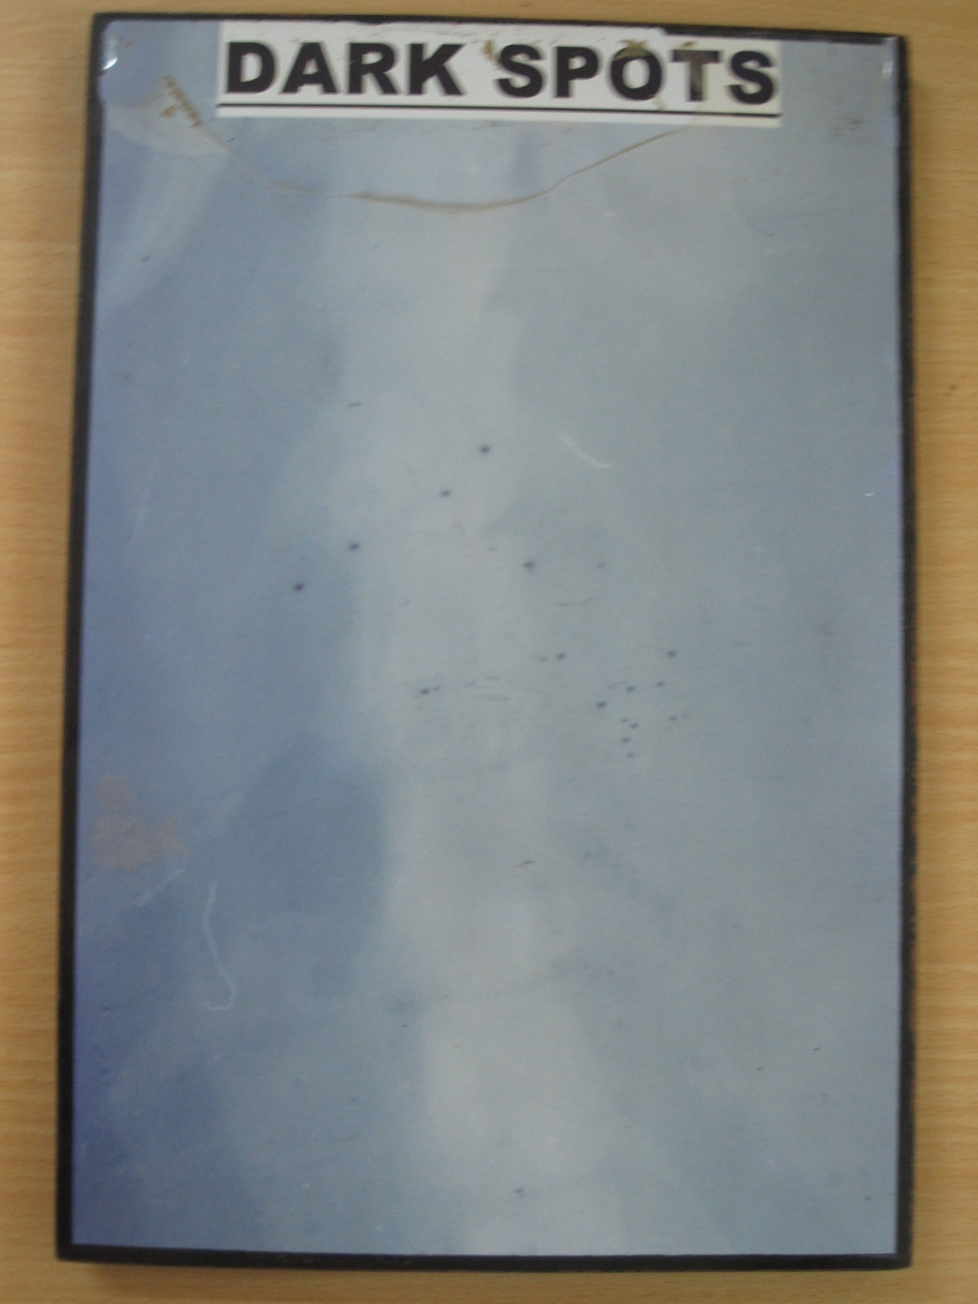

Slide 31
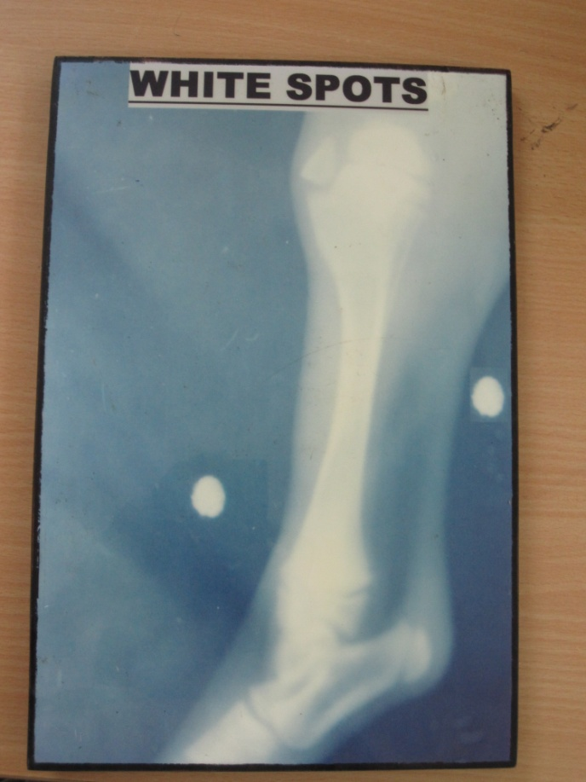
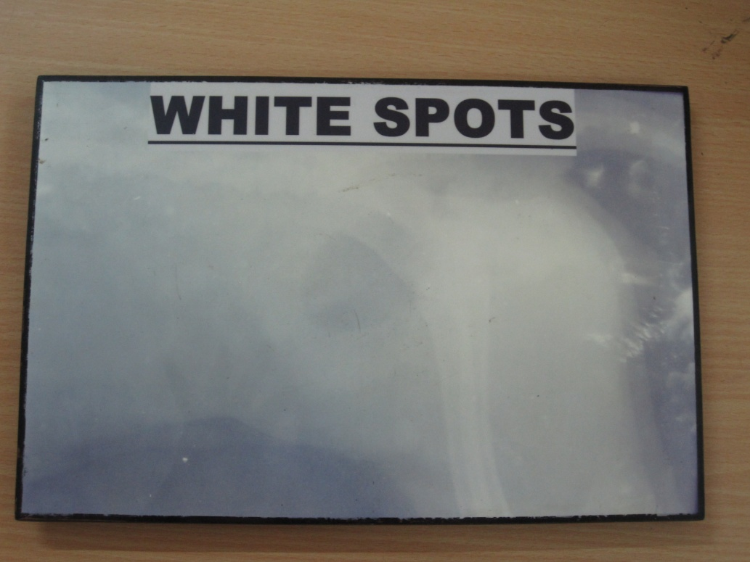
white spots:
pitted screen
dust with radioopaque base
splash of water or fixer before processing
airbells trapping during development
scratches on emulsion

Slide 32
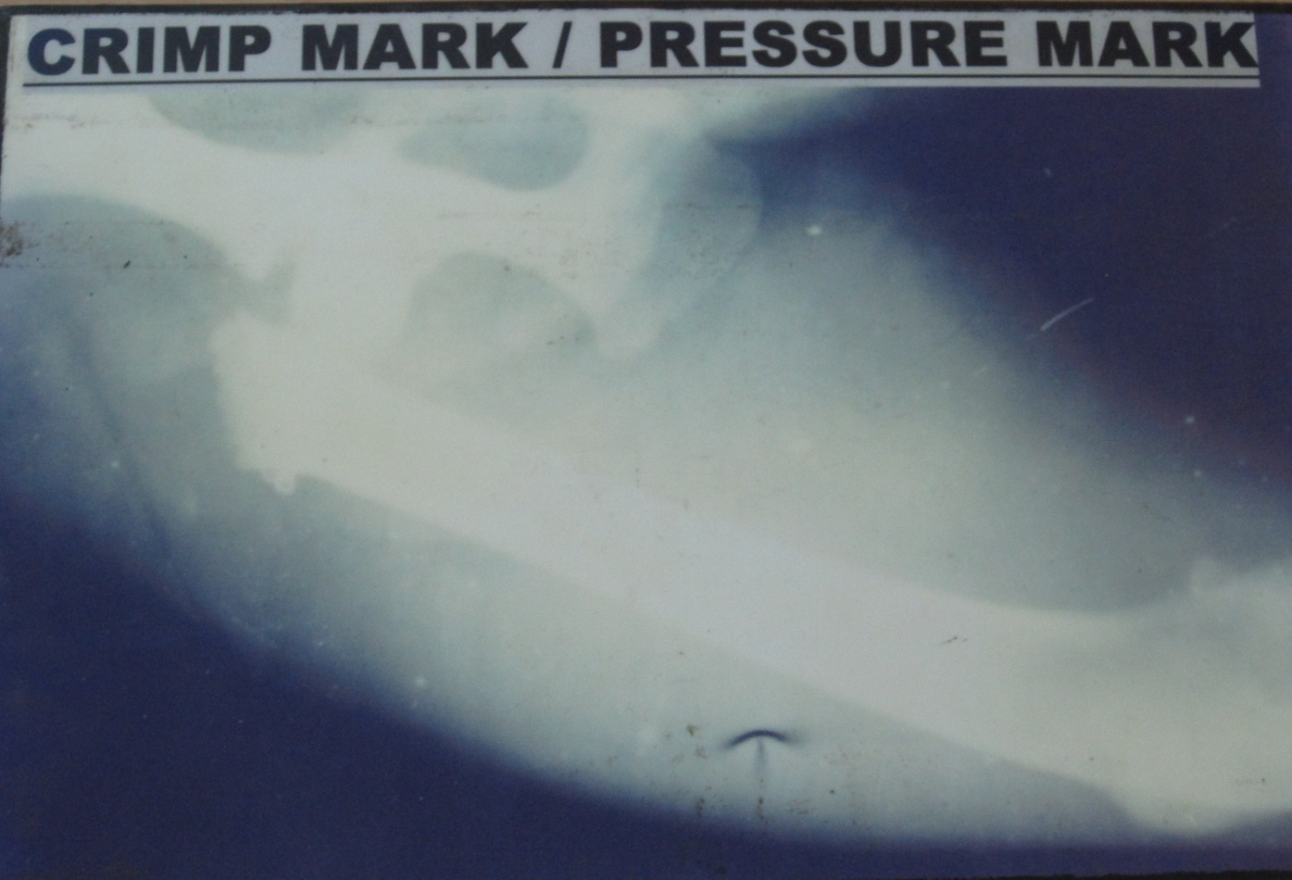
Crescent shaped black marks:
sharp bending of the film before development

Slide 33
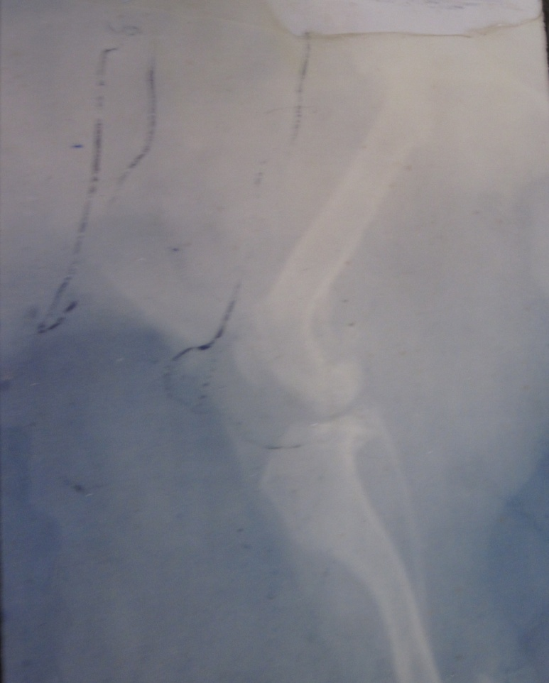
Black static marks:
Marks develop due to static electricity discharge
as a result of improper handling during its removal from the box , loading or unloading of the cassette.
Low humidity in the room.

Slide 34
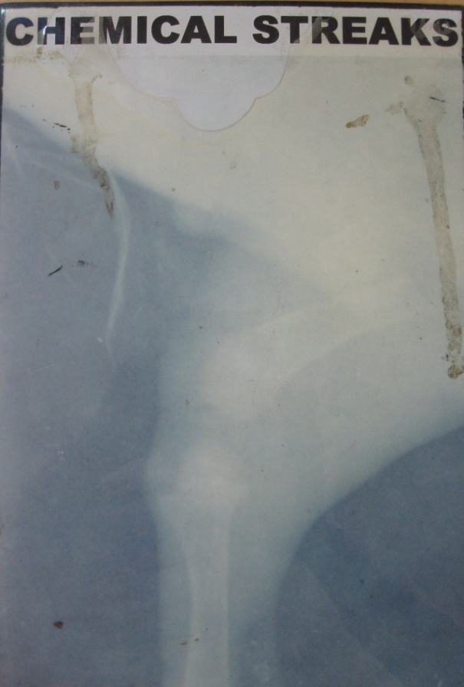
Chemical streaks:
Insufficient film agitation during processing
Dirty film hangers
Insufficient rinsing
Running down of water drops on semi dried film
water splashes
Dirty water used for washing of film

Slide 35
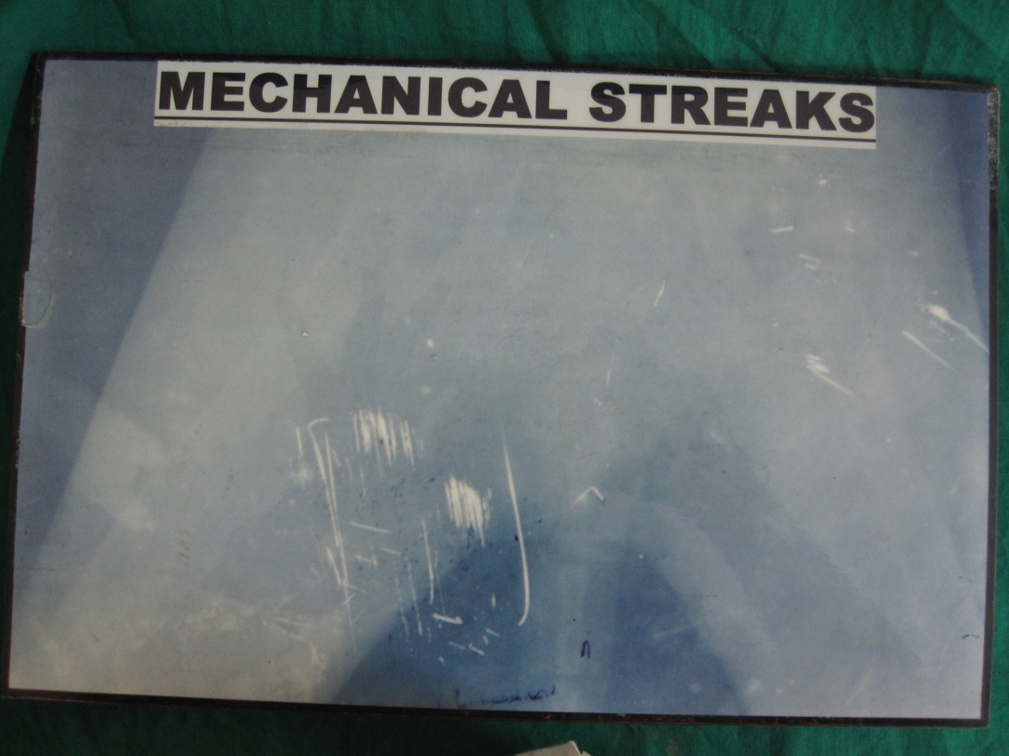
Mechanical streaks:
Dark scratches occur on film while loading or unloading the cassette
white scratches occur during processing when hanger of film scratches across the surface of another film.

Slide 36
Distorted / Blurred image:
Blurred image due to motion of patient , X-ray tube or cassette during exposure.
Distorted image due to poor film screen contact , improper centering of primary beam, central beam being not perpendicular to he cassette.

Slide 37
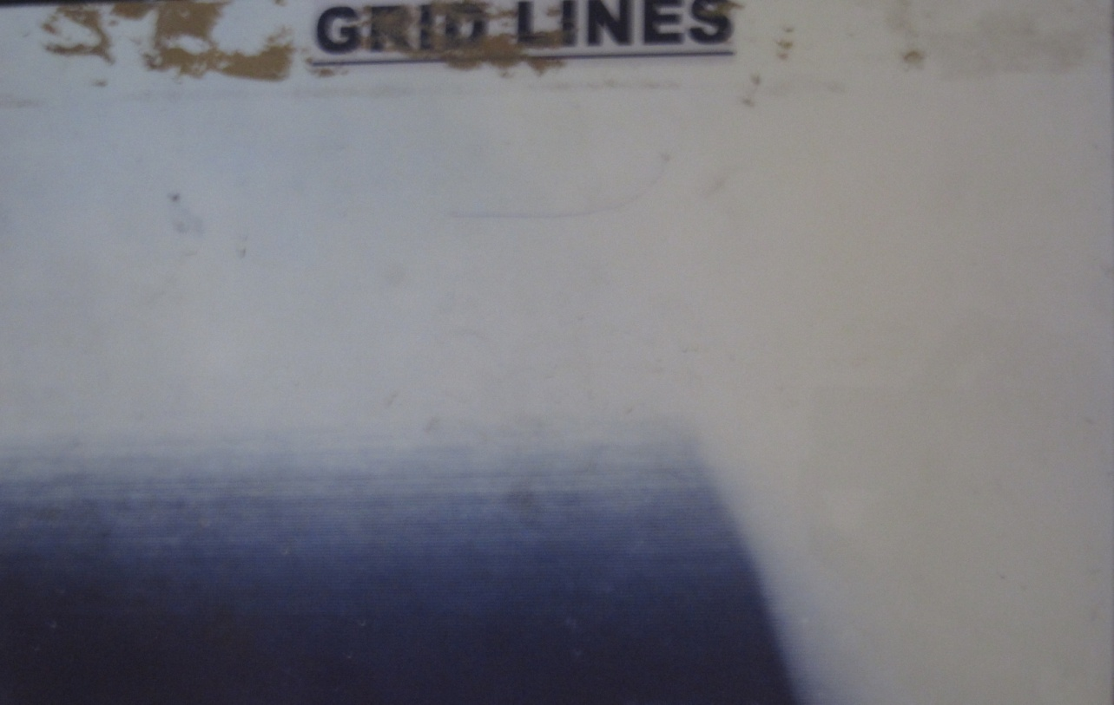
Grid faults:
grid lines due to wrong focal film distance outside range of grid radius.
Grid lines on the film due to off centering from midline.
Central beam is not perpendicular to the grid
Grid lines on both edges of film

Slide 38
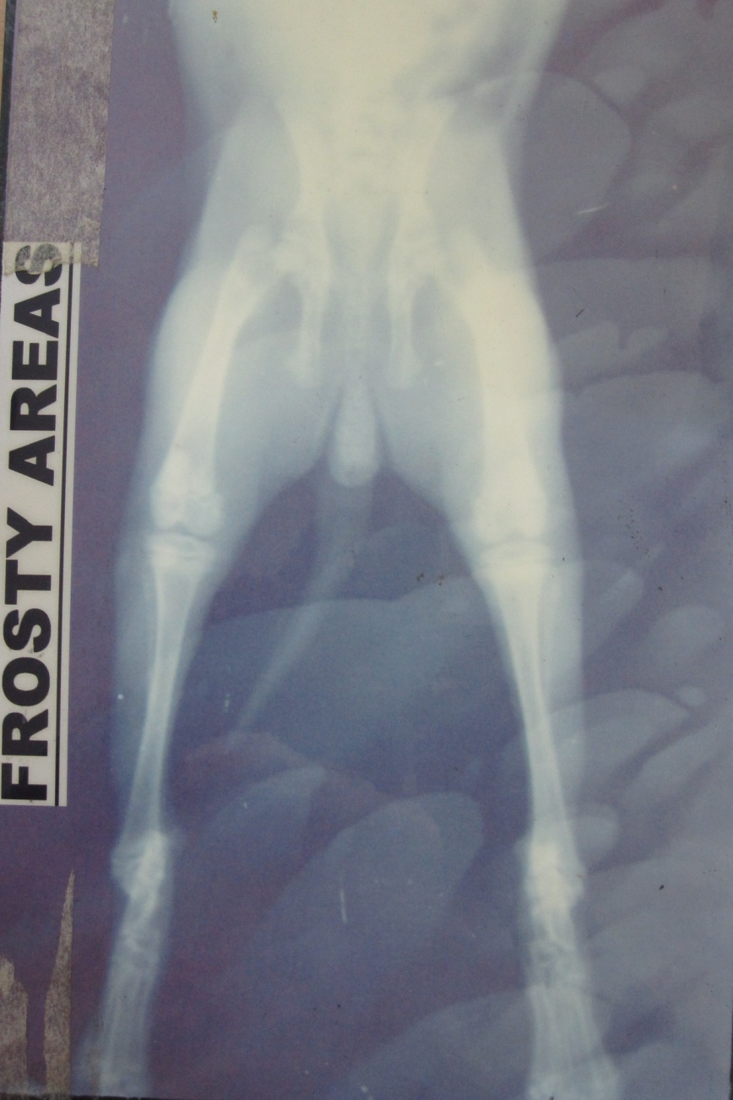
Frosty areas:
Improper final washing

Slide 39
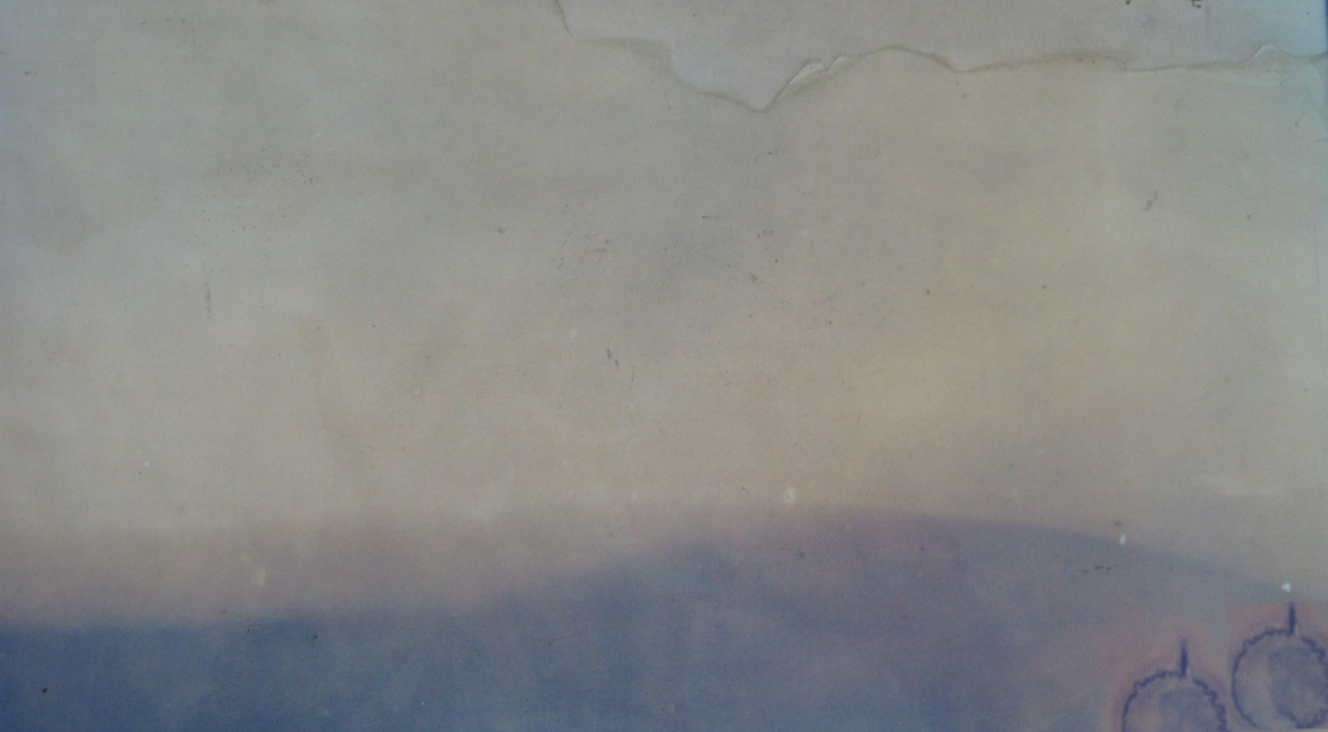
Yellow radiograph:
Use of exhausted or diluted fixer
Insufficient fixations

Slide 40
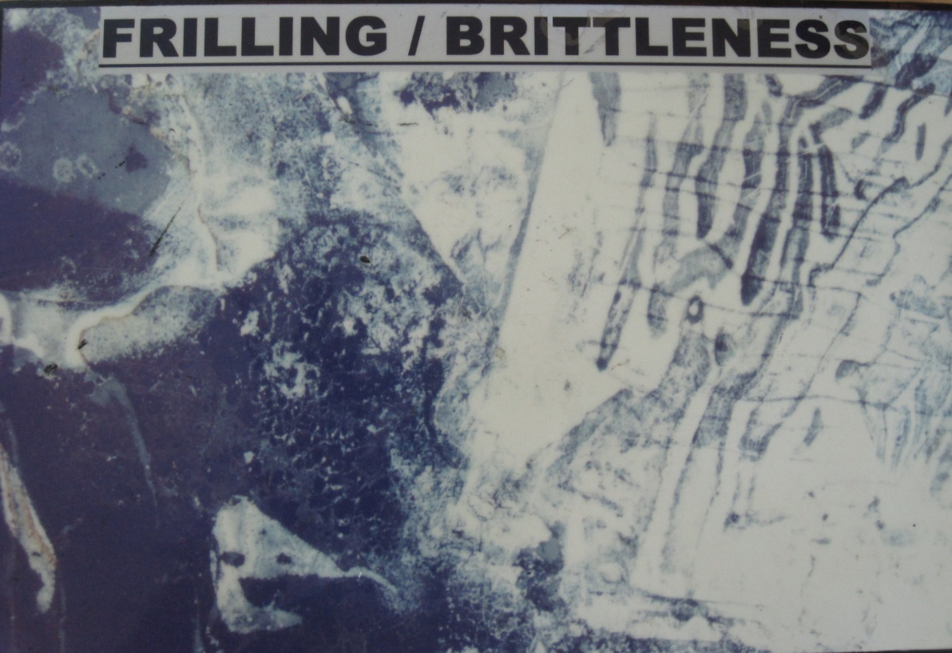
Brittleness:
Excessive drying temperature or prolonged drying
time.
Excessive fixation.

Slide 41
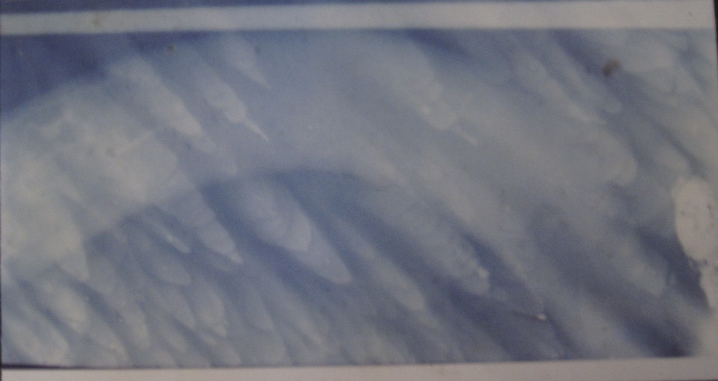
Finger marks:
Handling of the film with dirty , greasy or contaminated hands.

Slide 42
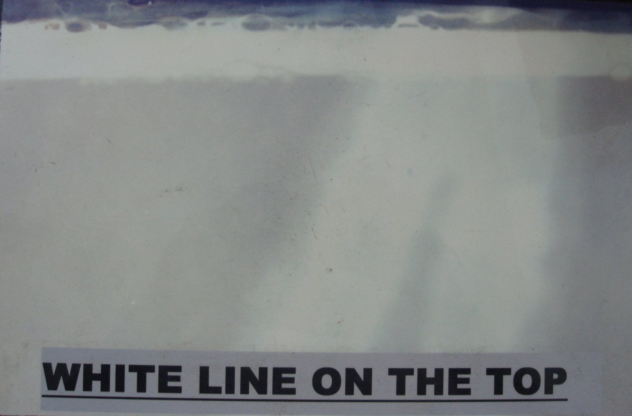
White horizontal area on top:
Low level of developer in tank

Slide 43
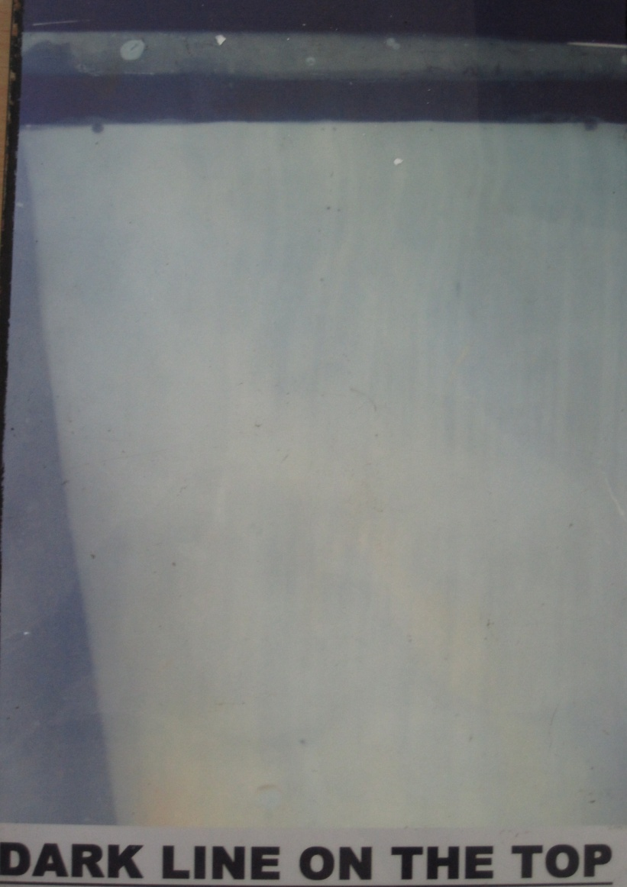
Dark horizontal area on top of the film:
Low level of fixer in the tank.

Slide 44

Frilling of gelatin:
Use of excessive hot solutions for processing

Slide 45
Blank film:
Film not exposed
central beam not properly directed & centred on the cassette.

Slide 46
References
A.p.singh veterinary surgery
Lavin Radiography in veterinary technology
May and baker radiographic manual 1966.
Sweeny , R.J. 1983 .Radiographic artifacts : their cause and control . J.B .Lippincott Co., New york

